Slide 1

Premium Knowledge Exchange
DRESS CODE

Slide 2
DRESS CODE
A set of rules, often written with regards to what clothing groups of people must wear
Identifies a PremiumTrust person and makes employees easily recognizable
Helps shape the PremiumTrust culture of excellence and professionalism
Allows PremiumTrust set expectations regarding the image it wants the company to convey
Eliminates subjectivity in wardrobe choices and ensure fair treatment
Promotes confidence, productivity and safety

Slide 3
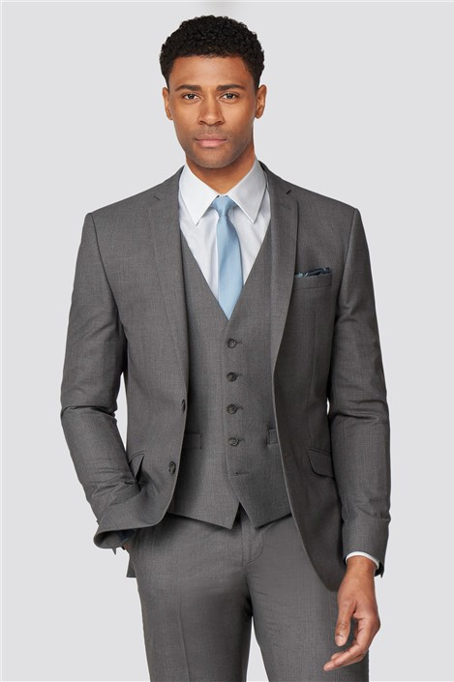
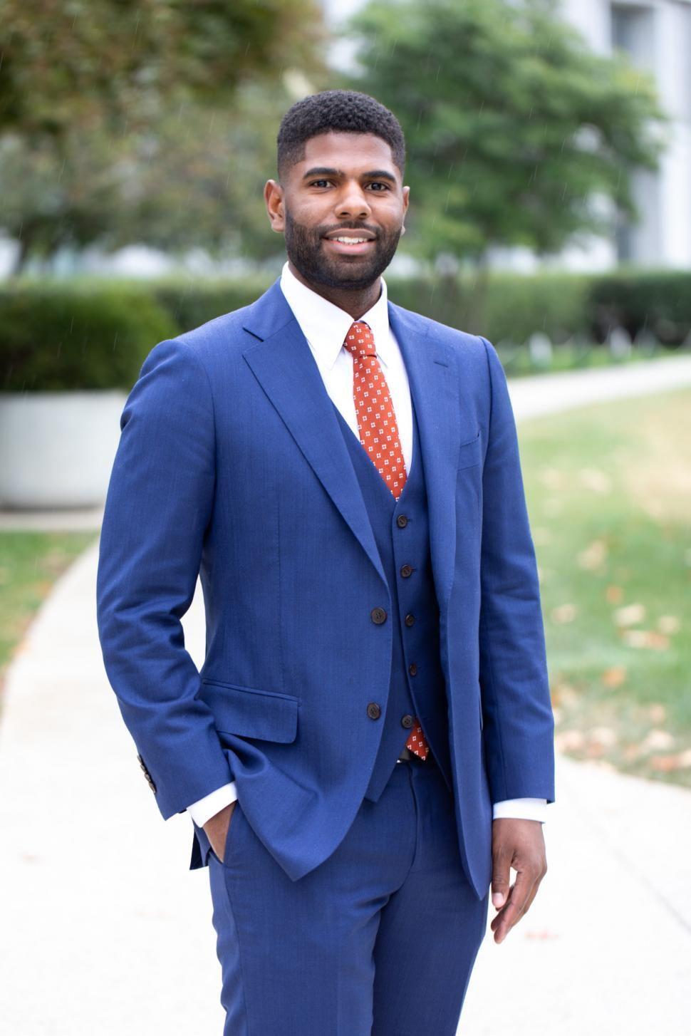
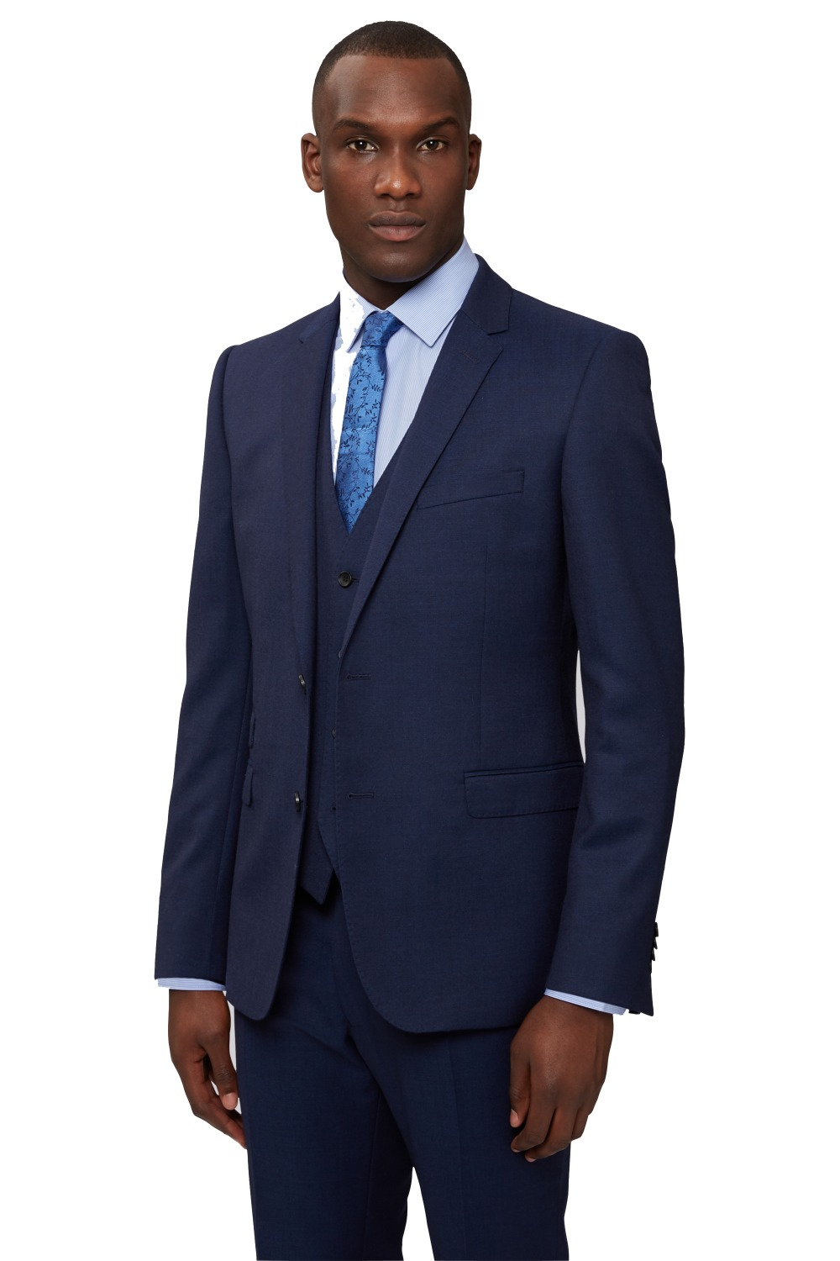
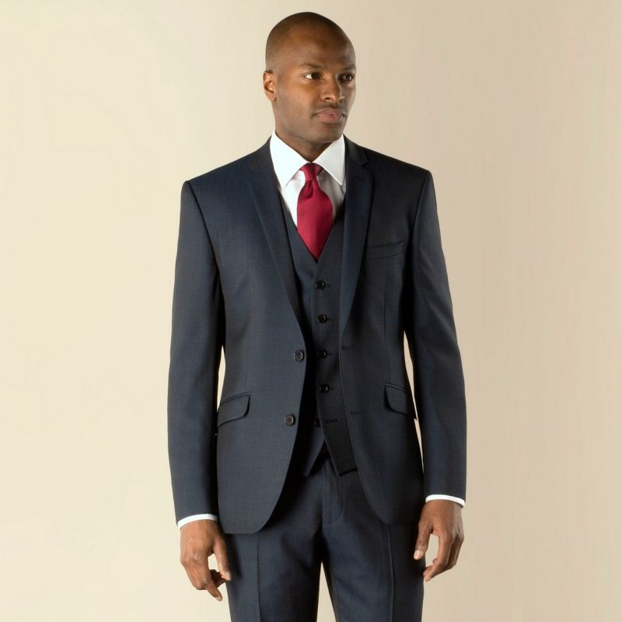
PremiumTrust
GENTS
(MONDAYS - THURSDAYS)

Slide 4
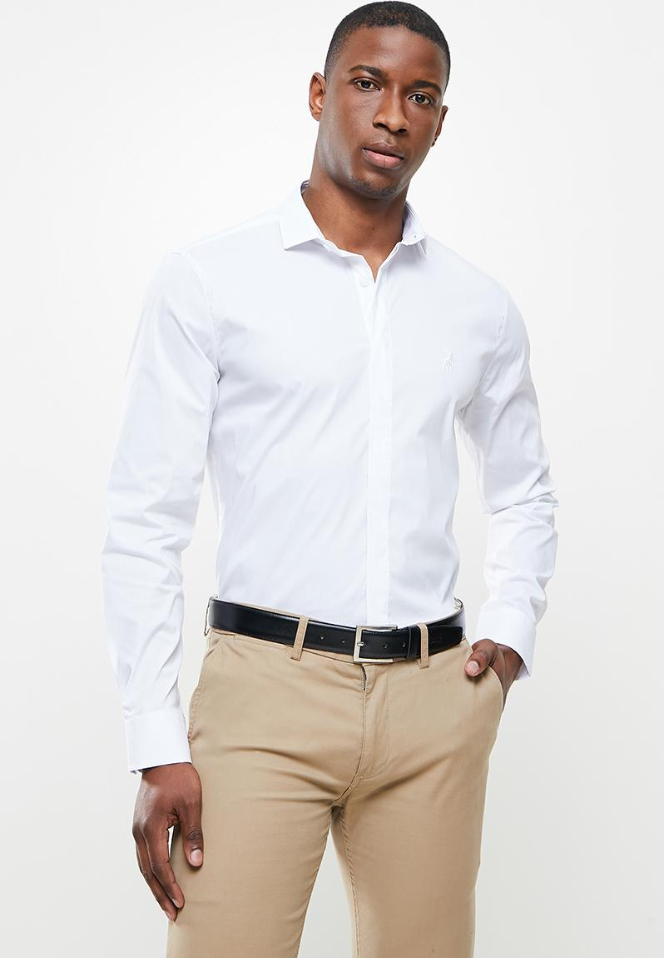
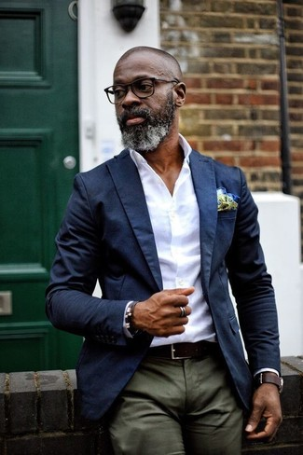
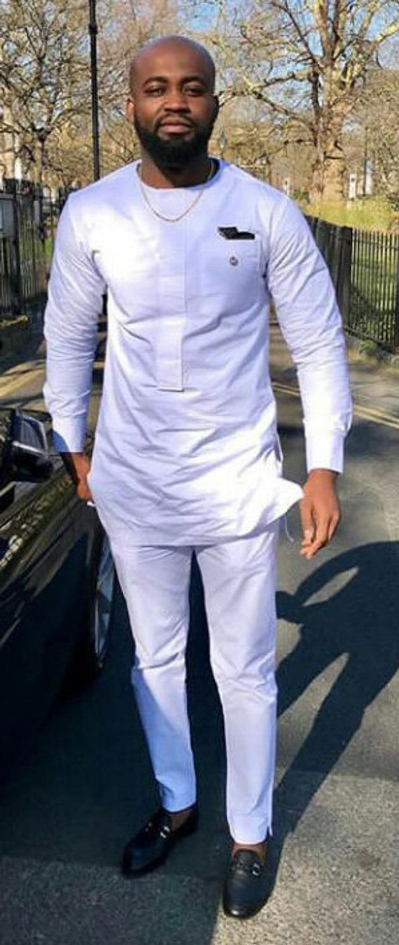
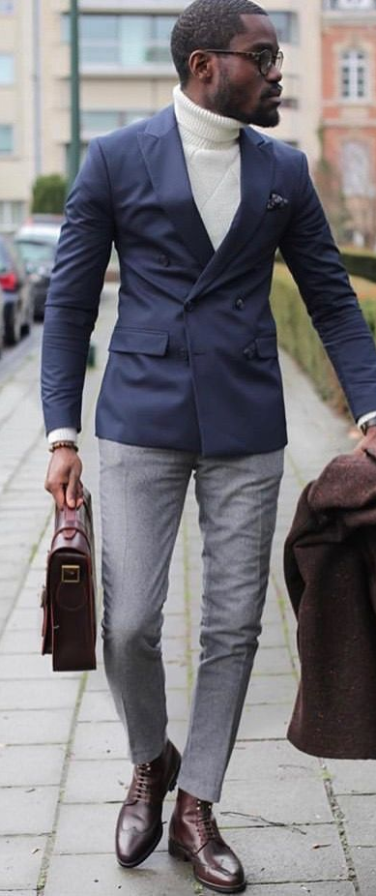
PremiumTrust
GENTS
(FRIDAYS)

Slide 5

MONDAYS to THURSDAYS (Corporate Wears only)
Three (3) piece suits
Dark colours – Black, Navy blue and Grey
Stripes or patterns should be thin and light – pin stripes
Shirts
Only White shirts are allowed
Stripped shirts are NOT allowed
Shoes
Shoes will be only in two colours – black or brown
Shoes can either be laced or buckled
Loafers, half shoes or Sandals are NOT allowed
Belts
Belts will be only in two colours – black or brown and must match with the shoe colours
Ties
Colourful ties

Slide 6
FRIDAYS (Business Casual / Native Attire / Branded Shirts)
Jackets / Blazers
Dark colours in Black, Brown, Navy blue, light and dark Grey
Strips or patterns should be thin and light – pin strips
Trousers
Chinos and normal trousers / pants in colours such as black, blue, brown, ash (in all shades)
Jeans can be worn in two colours only - Blue or black
Torn jeans, bleached jeans and frays are not allowed
Shirts
Short or long sleeves, properly tucked in.
Casual shirts include shirts, sweaters, turtle-necks in any colours
Branded T-shirts can be worn on Fridays or other approved days
Native Wears
Plain coloured and smart native wears can be worn on Fridays.
Ankara or tie/dye materials are NOT allowed
Shoes
Normal corporate shoes or any type of covered shoes can be worn.
Sandals, half shoes or palm slippers are NOT allowed

Slide 7
PERSONAL GROOMING
Ensure to wear clothes that fit your size perfectly.
Avoid wearing strong perfume / scents / aftershaves.
Always ensure that shoes are clean and well polished.
Ensure hair is properly cut and styled. Dread locks, braids, drawings and tints are NOT allowed.
Carry a properly trimmed beard always. No tints are allowed.
Avoid wearing neon or flashy colored attires.

Slide 8
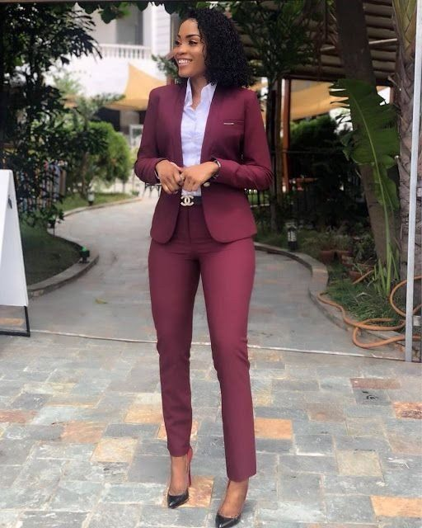
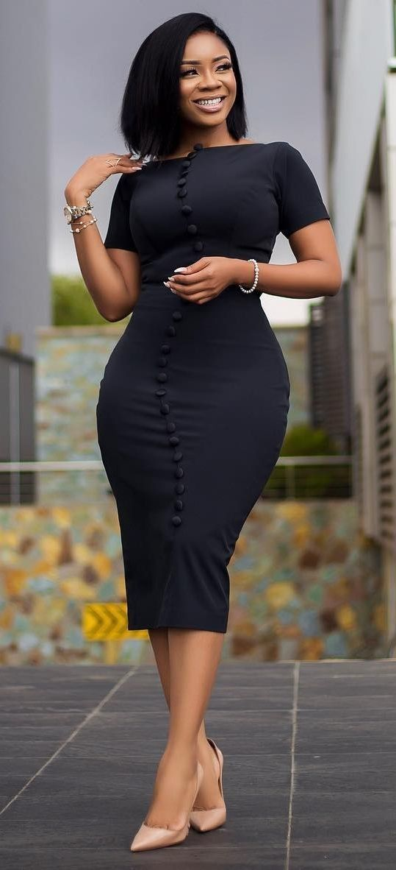
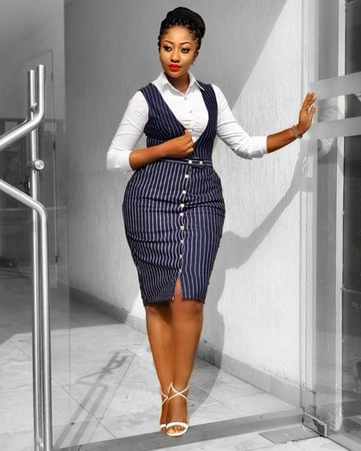
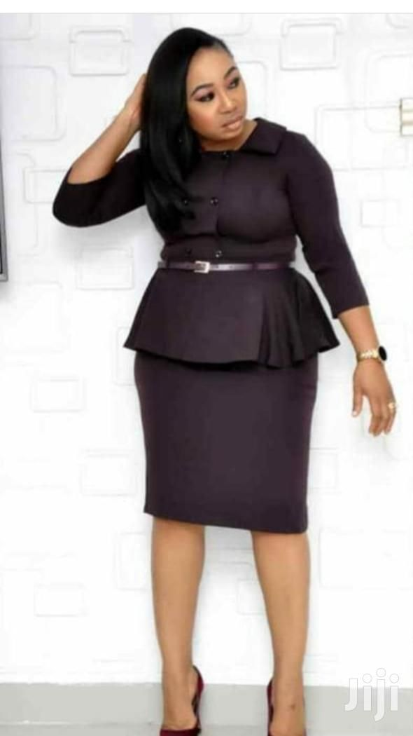
PremiumTrust
LADIES
(MONDAYS - THURSDAYS)

Slide 9
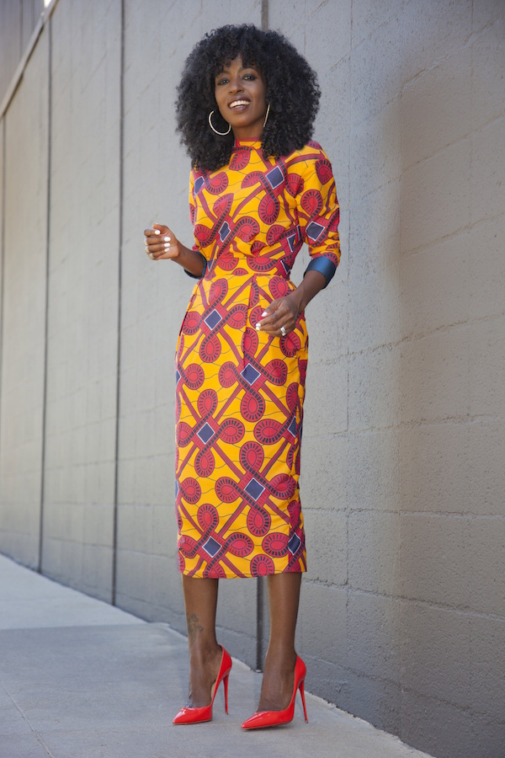
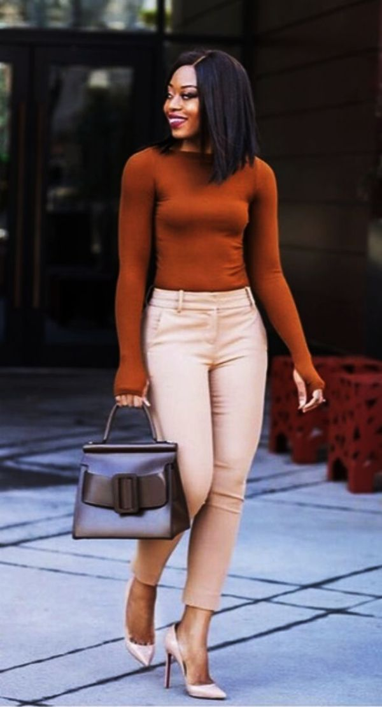
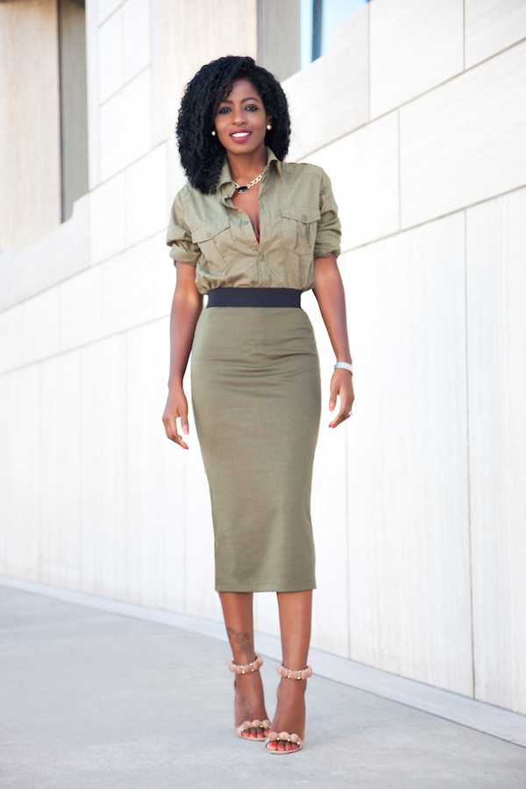
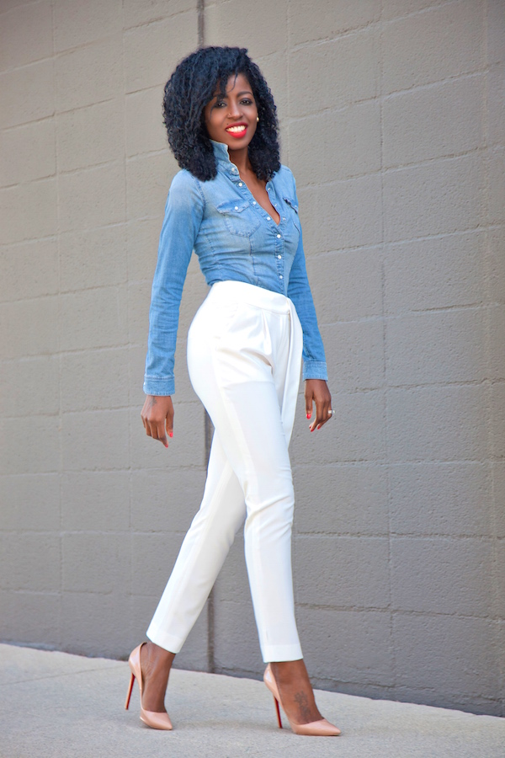
PremiumTrust
LADIES
(FRIDAYS)

Slide 10

MONDAYS to THURSDAYS (Corporate Wears only)
Dark colours – Black, Brown, Burgundy, Royal blue, Navy blue, light and dark Grey (or any dark colours).
Suit jackets can be long sleeves or short sleeves.
Suits can be worn with skirts, trousers or a dress.
Suits
Dark colours – Black, Brown, Burgundy, Royal blue, Navy blue, light and dark Grey (or any dark colours). If bright colours, a dark-coloured jacket MUST be worn on it.
Dresses worn without jackets MUST be short, elbow length or long sleeves.
Sleeveless dresses are NOT allowed.
Dresses
Shirts
Acceptable colors are light green, lilac, red, grey, baby pink, sky blue, white, black, wine, orange, peach, purple.
Camisoles should always be worn with a jacket.
Acceptable colours are Black, Navy Blue, Grey, Brown, Green, Nude, Burgundy, Purple (cool). Bright colored shoes are prohibited.
Leather, patent and suede shoes are acceptable. Slingbacks and peep toes are also acceptable.
Shoes

Slide 11
FRIDAYS (Business Casual – Branded shirt on jeans)
Shirts / Jackets
Shirts and jackets can be worn in any colours.
Trousers and skirts in any colours are allowed.
Jeans can be worn in two colours only - Blue or Black
Torn jeans, bleached jeans and frays are not allowed.
Trousers / Skirts
Dresses
Dresses can be worn in any colours.
Dresses worn without jackets MUST be short, elbow length or long sleeves.
Sleeveless dresses are NOT allowed.
Native Wears
Plain coloured and smart native wears can be worn on Fridays.
Ankara wears are also allowed
Shoes
Normal corporate shoes or any type of shoes can be worn.

Slide 12
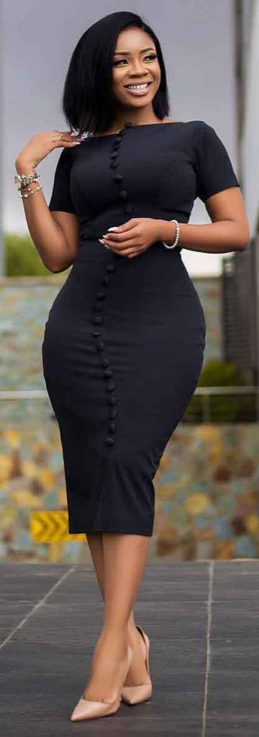
PERSONAL GROOMING
Ensure to wear clothes that fit your size perfectly.
Avoid wearing strong perfume / scents.
Always ensure that shoes are clean and well polished.
Ensure hair is properly styled or packed. Weaves, Braids or Tints should be close to natural shades and subtle. Drawings on hair are NOT allowed.
Make up and other accessories should be minimal.
Avoid wearing neon or flashy colored attires.

Slide 13

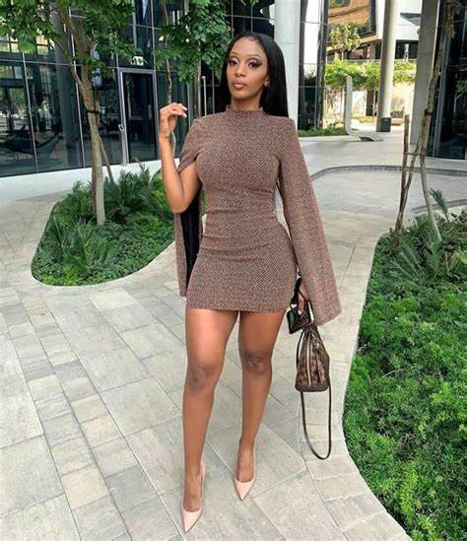
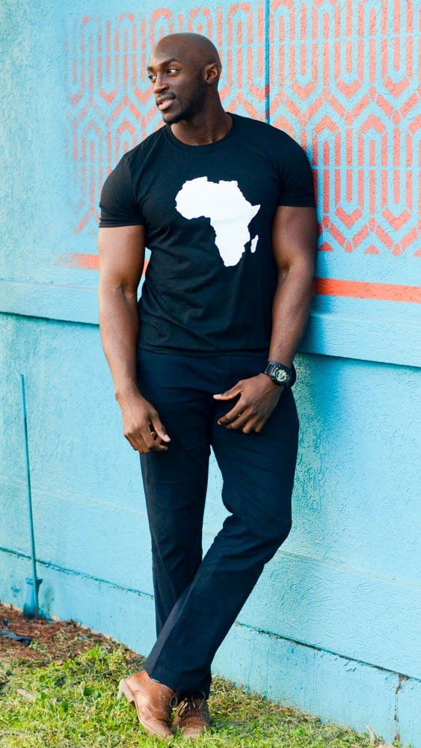
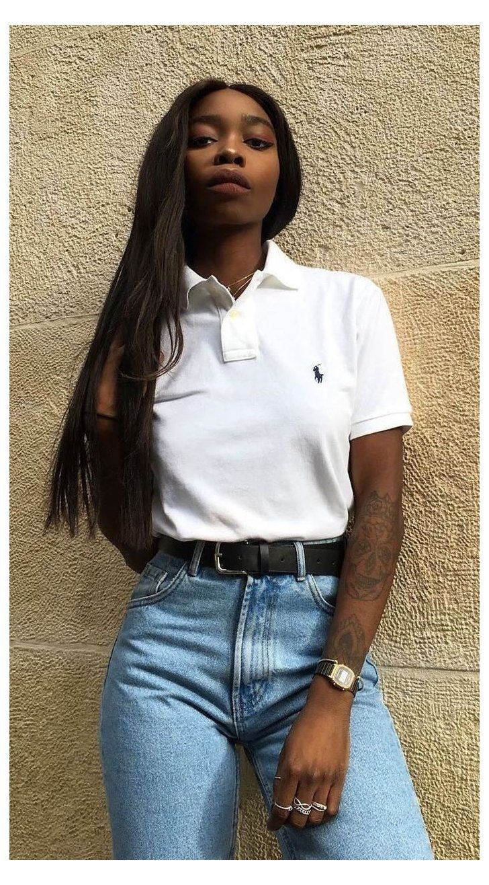
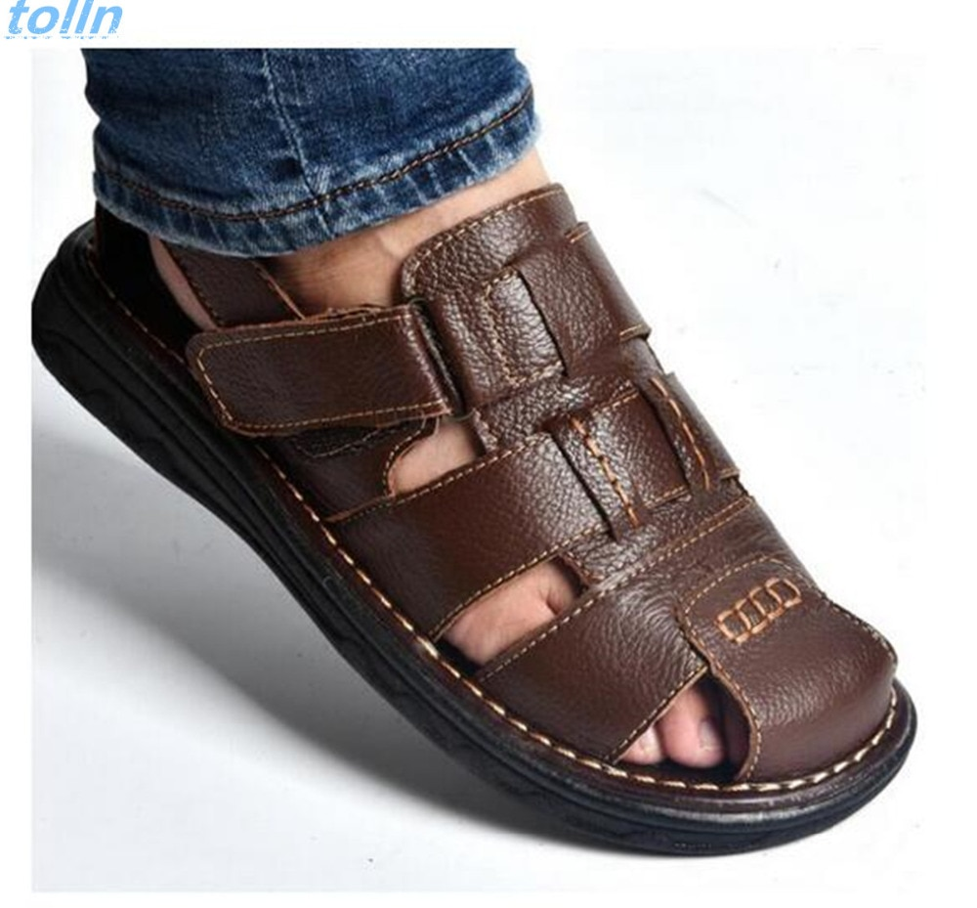
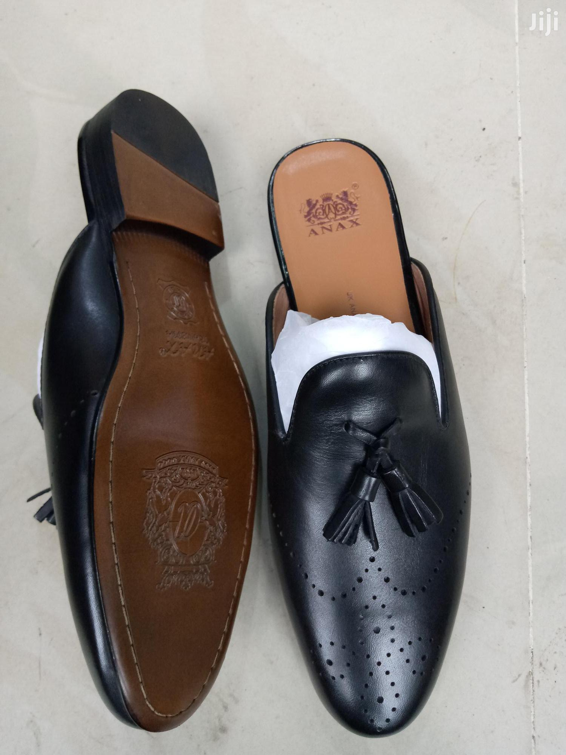
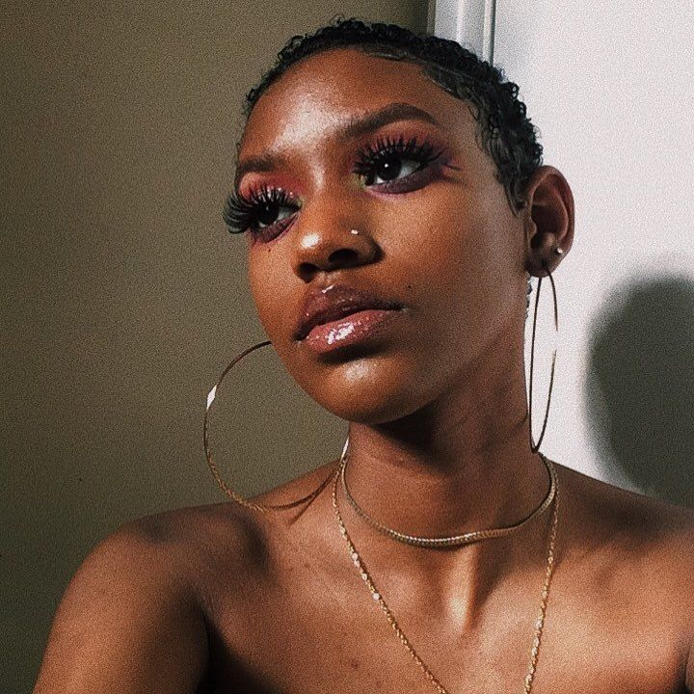
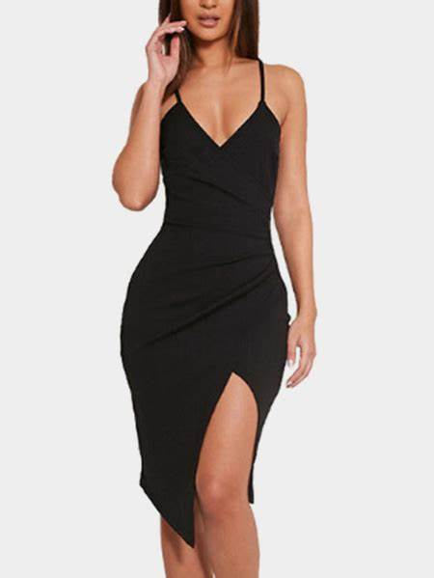
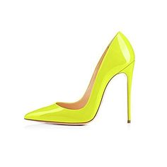
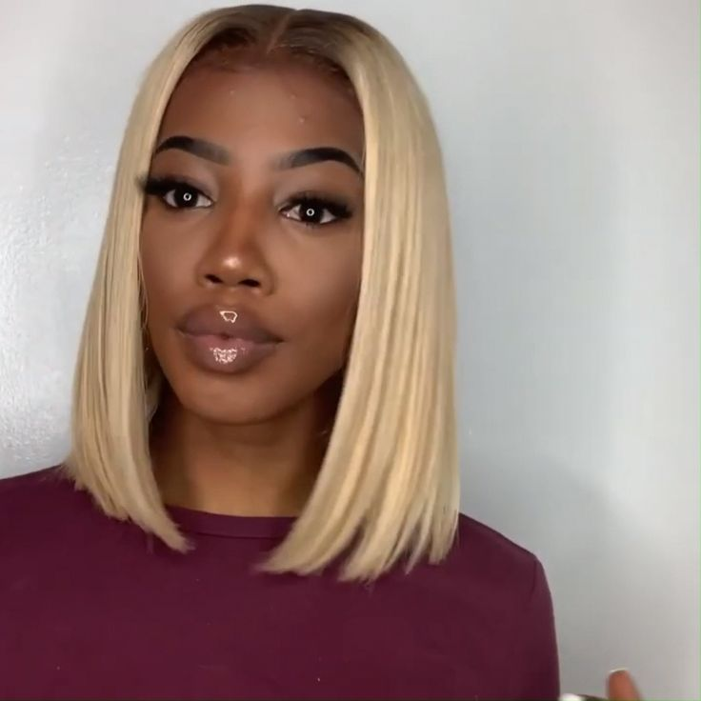
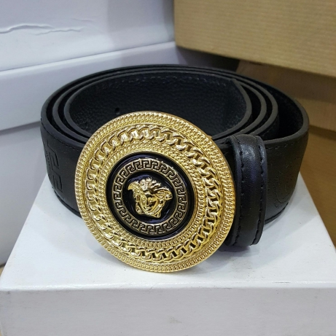
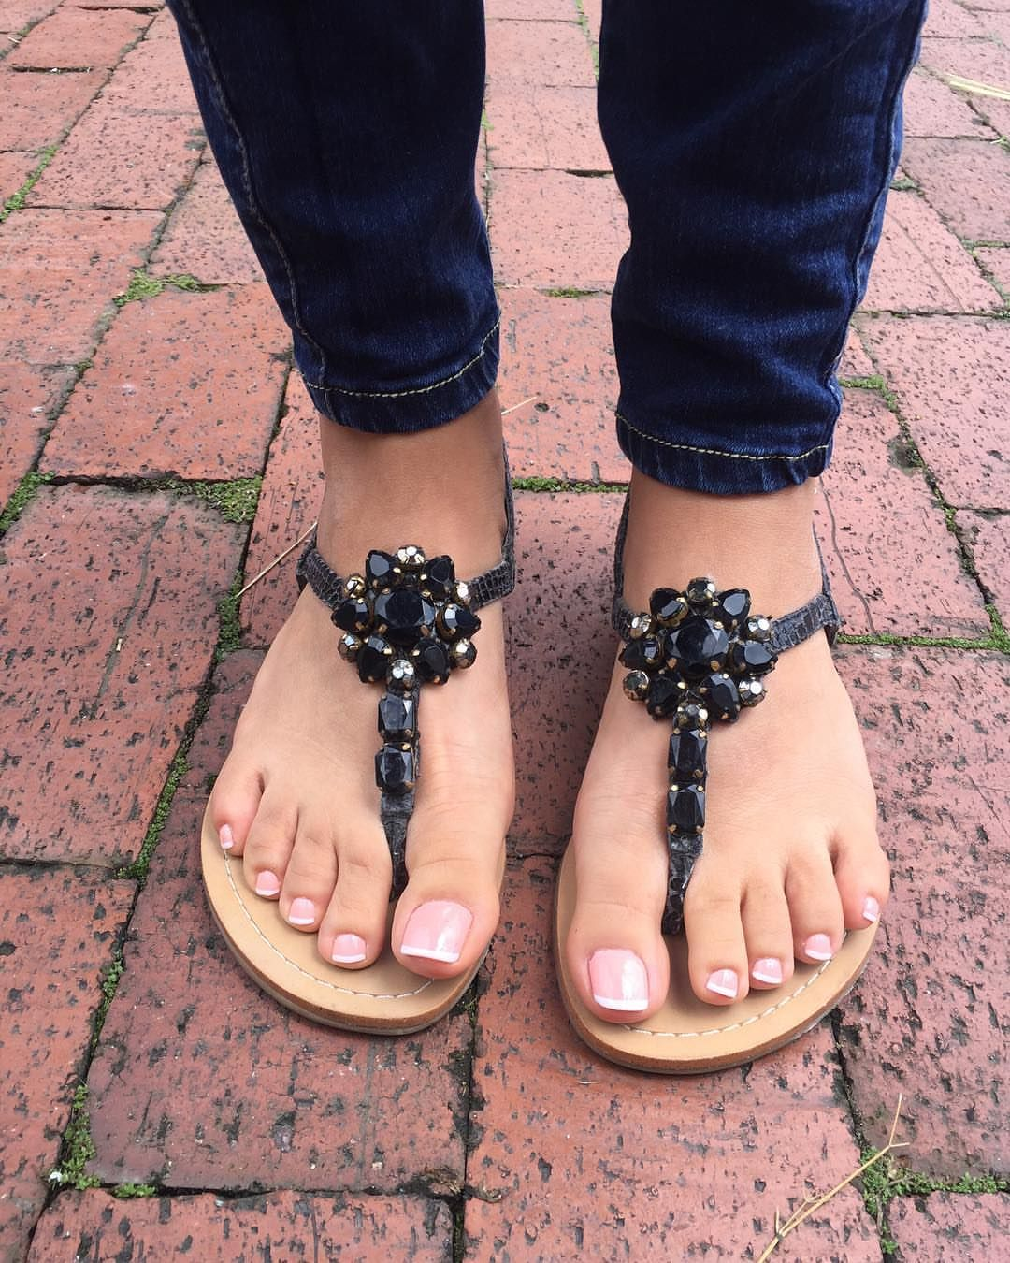
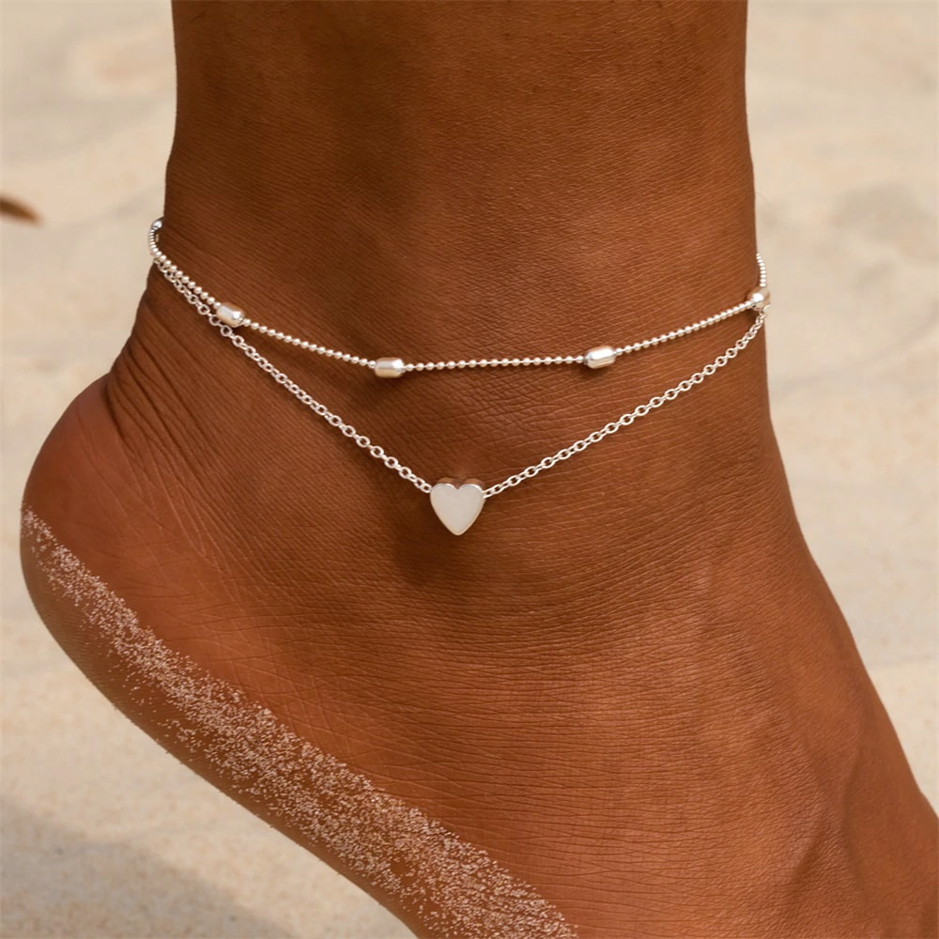
UNACCEPTABLE
PremiumTrust

Slide 14
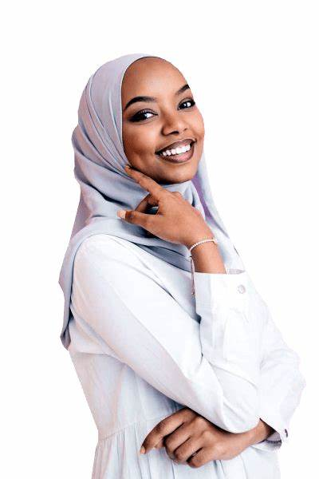
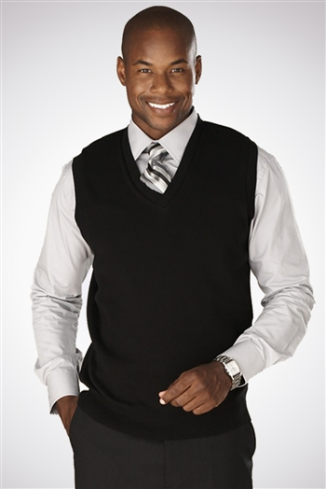
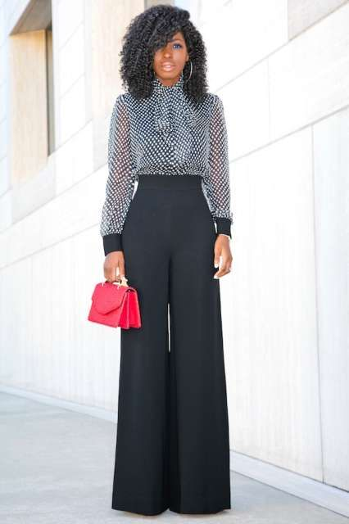
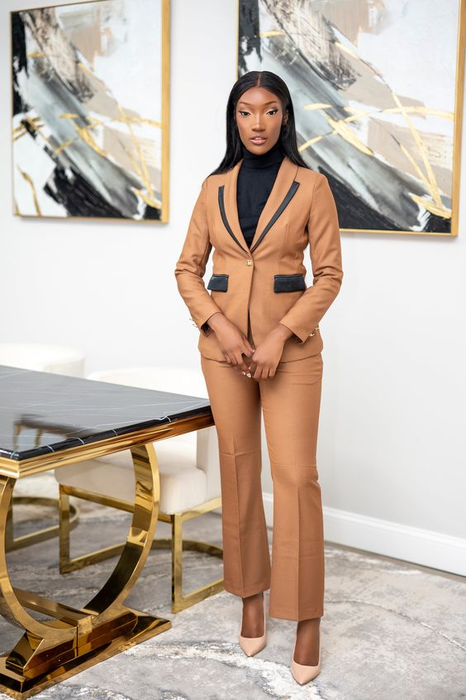
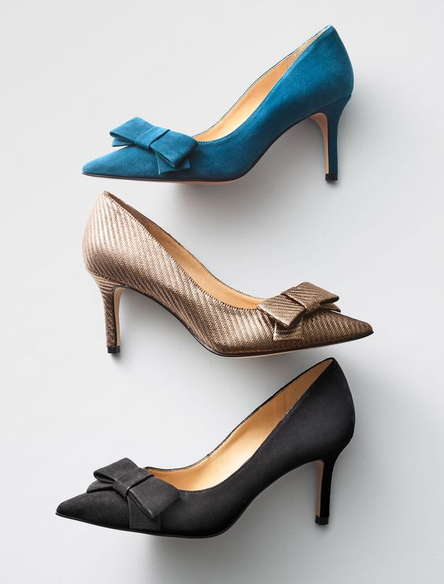
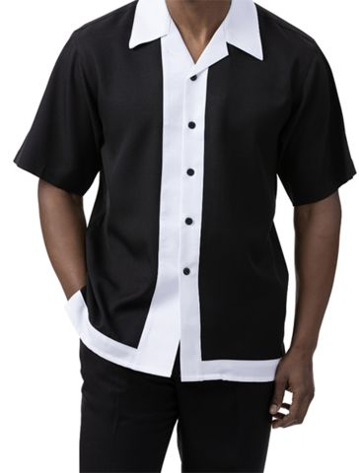
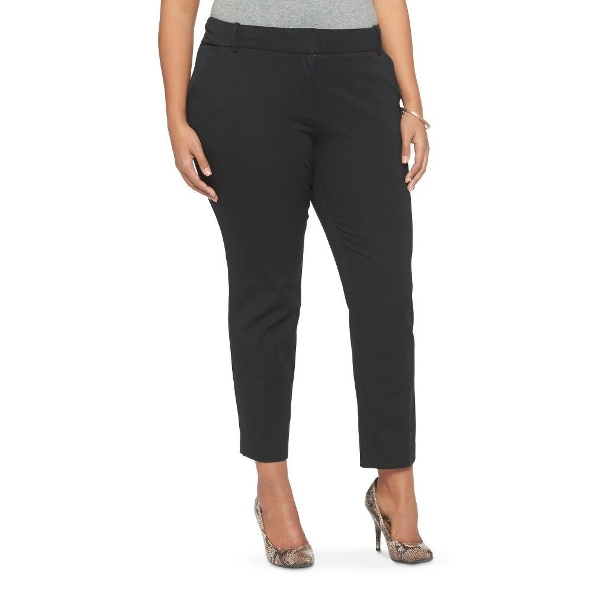
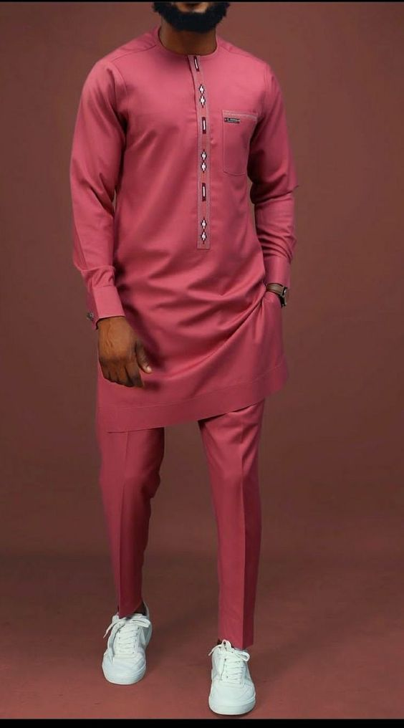
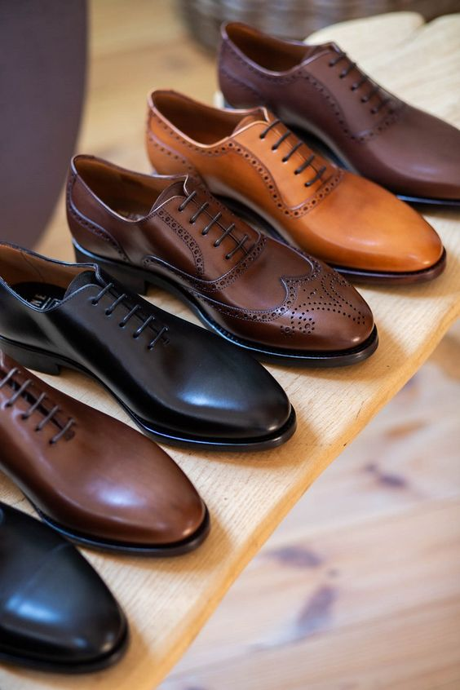
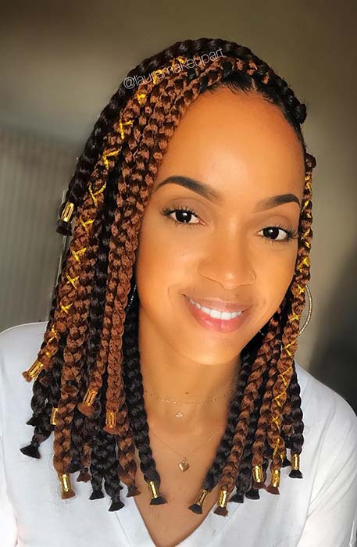
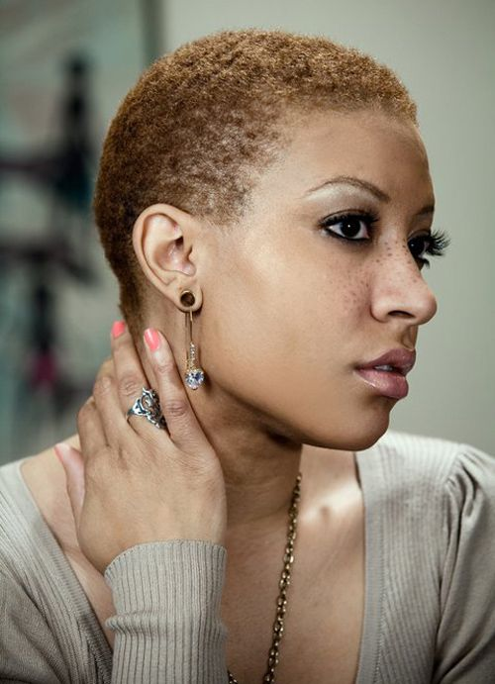
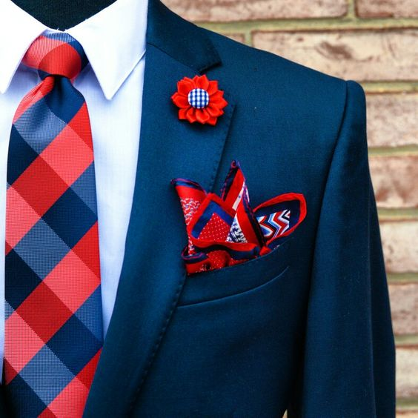
ACCEPTABLE
PremiumTrust

Slide 15
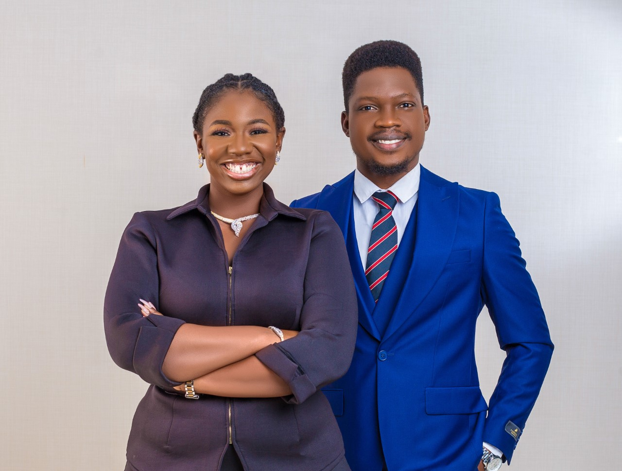
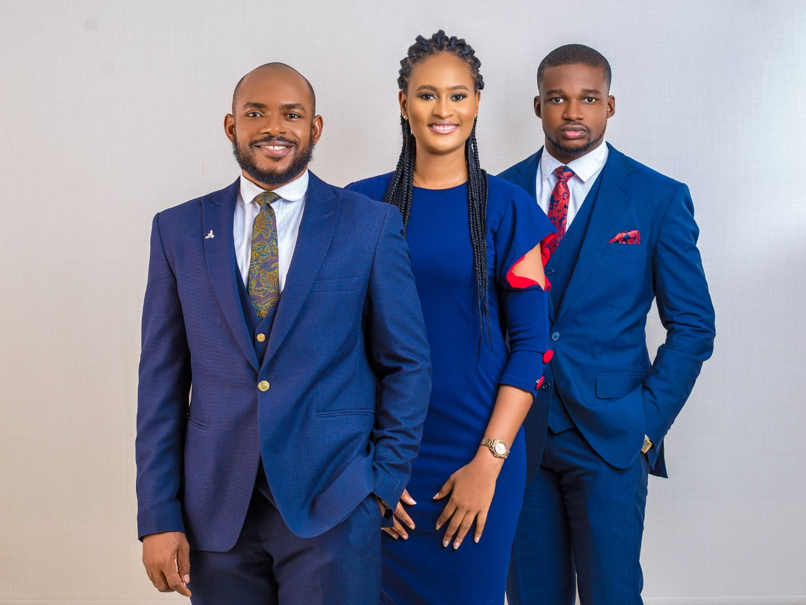
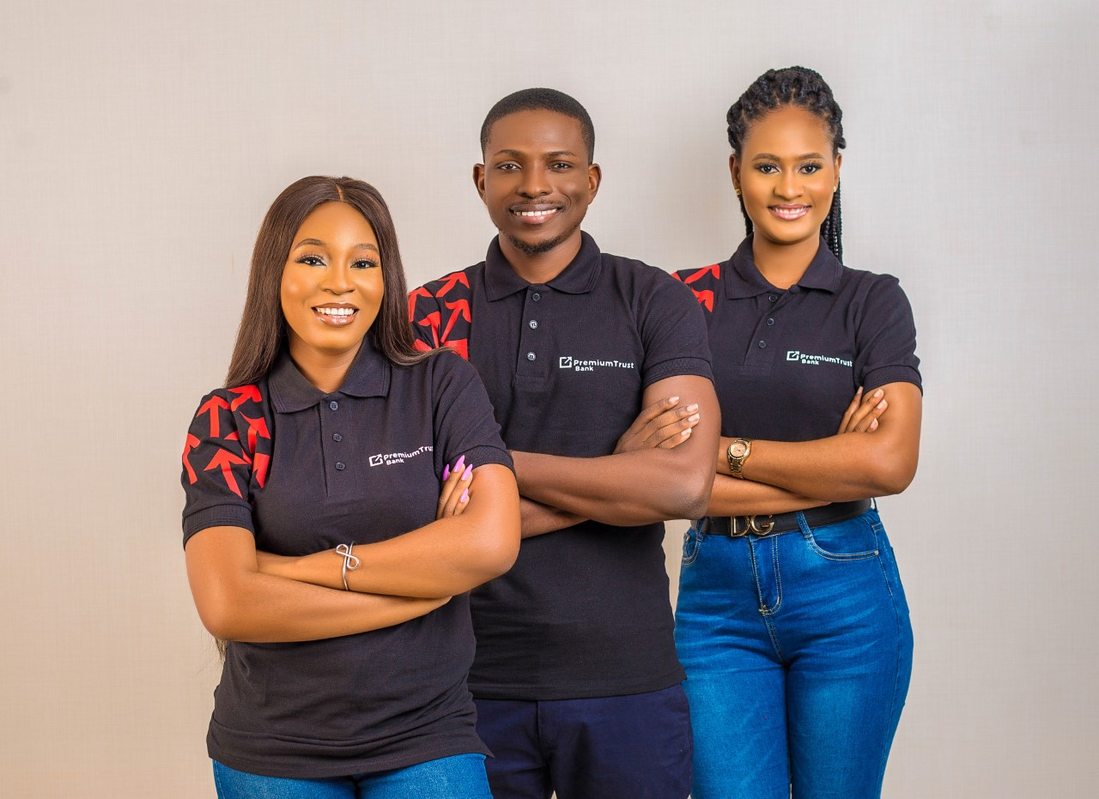
PERSON
PremiumTrust

Slide 16


